Slide 1
Cryptography (2021 Fall) PRG with arbitrary expansion, stream cipher, IND-m-EAV, IND-CPA, IND-m-CPA
LiangFeng Zhang
zhanglf@shanghaitech.edu.cn
SIST, ShanghaiTech

Slide 2



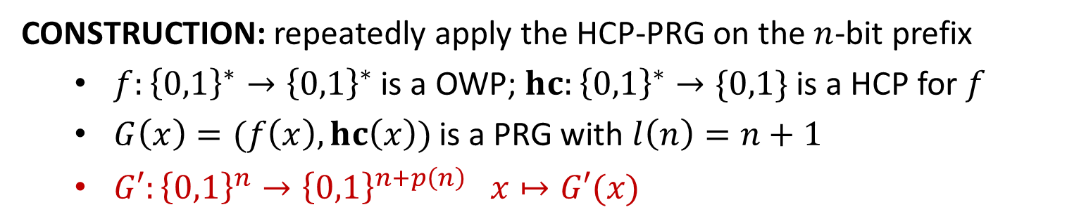
















PRG with Arbitrary Expansion
CONSTRUCTION: repeatedly apply the HCP-PRG on the $n$-bit prefix
$f:{\left\{0,1\right\}}^{∗}→{\left\{0,1\right\}}^{∗}$ is a OWP; $hc:{\left\{0,1\right\}}^{∗}→\{0,1\}$ is a HCP for $f$
$G\left(x\right)=(f\left(x\right),hc\left(x\right))$ is a PRG with $l\left(n\right)=n+1$
$G′:{\left\{0,1\right\}}^{n}→{\left\{0,1\right\}}^{n+p\left(n\right)} x↦G′(x)$
$$G′\left\{\begin{aligned} \\ \\ \\ \\ \\ \\ \\ \\ \\ \end{aligned}\right.$$
$$x$$
$$hc(x)$$
$$x$$
$$G↓$$
$$f(x)$$
$$hc(f(x))$$
$$hc(x)$$
$$G↓$$
$$f(f(x))$$
$$⋮$$
$$⋮$$
$$hc(f^{(p\left(n\right)−1)}(x))$$
$$f^{(p\left(n\right))}(x)$$
$$⋯⋯$$
$$G′(x)$$
$n$ bits
$p(n)$ bits
THEOREM: The function $G′$ is a PRG with expansion factor $n+p(n)$.

Slide 3


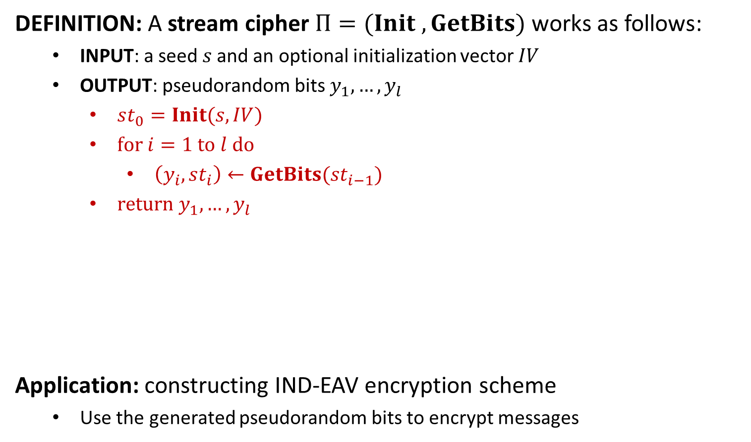








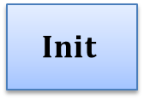


Stream Cipher
DEFINITION: A stream cipher $Π=(Init , GetBits)$ works as follows:
INPUT: a seed$s$and an optional initialization vector $IV$
OUTPUT: pseudorandom bits $y_{1},…,y_{l}$
$st_{0}=Init(s,IV)$
$for i=1 to l do$
$\left(y_{i}, st_{i}\right)←GetBits(st_{i−1})$
$return y_{1},…,y_{l}$
Application: constructing IND-EAV encryption scheme
Use the generated pseudorandom bits to encrypt messages
$$s$$
$$Init$$
$$st_{0}$$
$$GetBits$$
$$st_{1}$$
$$GetBits$$
$$st_{2}$$
$$GetBits$$
$$st_{3}$$
$$IV$$
$$⋯$$
$$y_{1}$$
$$y_{2}$$
$$y_{3}$$
$$⋯$$

Slide 5


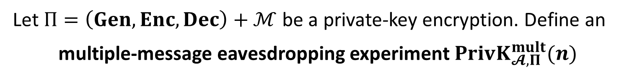



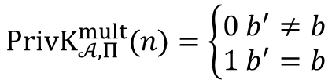


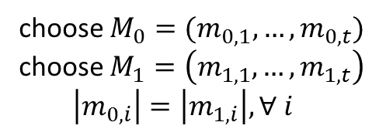

IND-m-EAV
Let $Π=\left(Gen, Enc, Dec\right)+ℳ$ be a private-key encryption. Define an
multiple-message eavesdropping experiment $PrivK_{𝓐, Π}^{mult}(n)$
choose $M_{0}=(m_{0,1},…,m_{0,t})$
choose $M_{1}=\left(m_{1,1},…,m_{1,t}\right)$
$\left|m_{0,i}\right|=\left|m_{1,i}\right|, ∀ i$
$$M_{0},M_{1}$$
$$k←Gen\left(1^{n}\right)$$
$$Challenger$$
$$b←\{0,1\}$$
$$Adversary 𝒜$$
$$c_{i}←Enc(k,m_{b,i})$$
$$C=(c_{1},…,c_{t})$$
$$b′$$
$$PrivK_{𝒜, Π}^{mult}(n)=\left\{\begin{aligned}0 b^{′}≠b \\ 1 b^{′}=b\end{aligned}\right.$$
$t$: can be any polynomial function in $n;$ chosen by the adversary

Slide 6
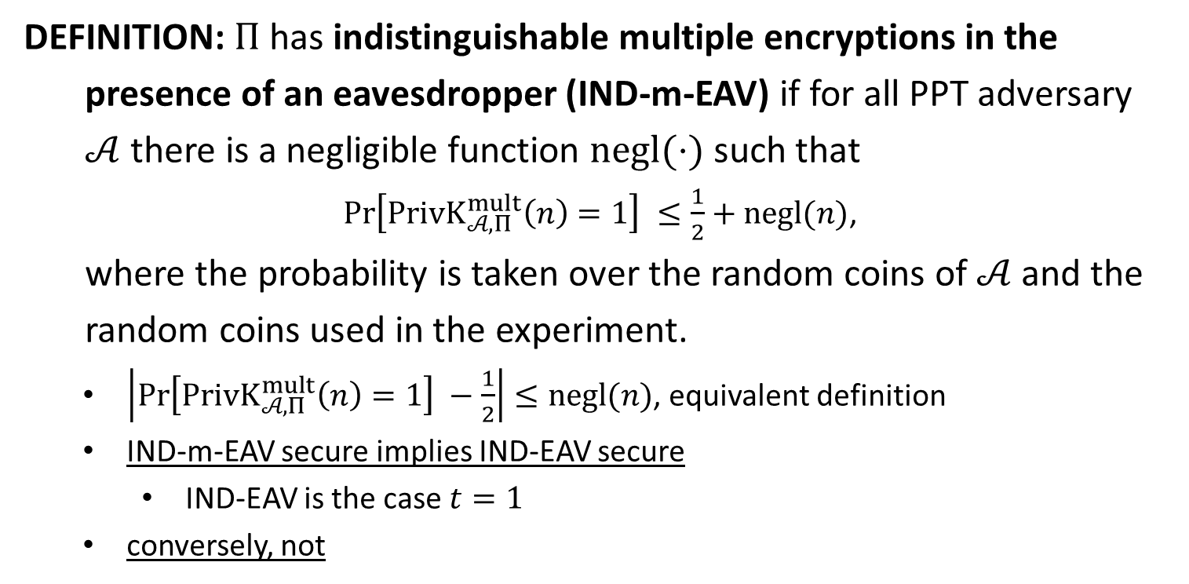
IND-m-EAV
DEFINITION: $Π$has indistinguishable multiple encryptions in the
presence of an eavesdropper (IND-m-EAV) if for all PPT adversary
$𝒜$ there is a negligible function $negl(⋅)$ such that
$\operatorname{Pr}\left[PrivK_{𝒜, Π}^{mult}\left(n\right)=1\right] ≤\frac{1}{2}+negl(n)$,
where the probability is taken over the random coins of $𝒜$ and the
random coins used in the experiment.
$\left|\operatorname{Pr}\left[PrivK_{𝒜, Π}^{mult}\left(n\right)=1\right] −\frac{1}{2}\right|≤negl(n)$, equivalent definition
IND-m-EAV secure implies IND-EAV secure
IND-EAV is the case $t=1$
conversely, not

Slide 7
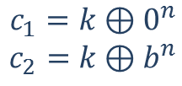

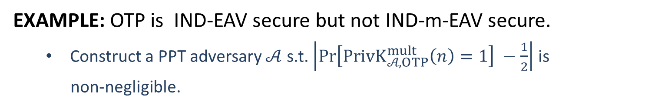






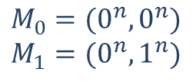

IND-m-EAV
EXAMPLE: OTP is IND-EAV secure but not IND-m-EAV secure.
Construct a PPT adversary $𝒜$ s.t. $\left|\operatorname{Pr}\left[PrivK_{𝒜, OTP}^{mult}\left(n\right)=1\right] −\frac{1}{2}\right|$ is
non-negligible.
$$M_{0}=(0^{n}, 0^{n})$$
$$M_{1}=(0^{n},1^{n})$$
$$M_{0},M_{1}$$
$$k←{\left\{0,1\right\}}^{n}$$
$$b←\{0,1\}$$
$$Challenger$$
$$Adversary 𝒜$$
$$c_{1}=k⊕0^{n}$$
$$c_{2}=k⊕b^{n}$$
$$C=(c_{1},c_{2})$$
$$b′$$
$$b^{′}=0 iff c_{1}=c_{2}$$

Slide 8
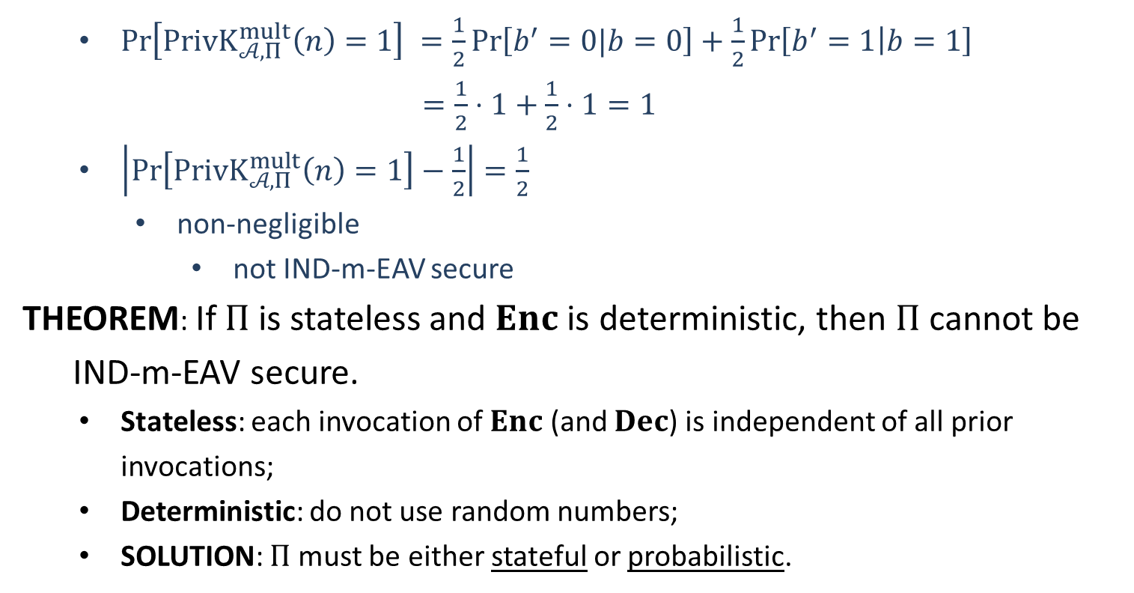
IND-m-EAV
$\operatorname{Pr}\left[PrivK_{𝒜, Π}^{mult}\left(n\right)=1\right] =\frac{1}{2}\operatorname{Pr}\left[b^{′}=0|b=0\right]+\frac{1}{2}\operatorname{Pr}\left[b^{′}=1 | b=1\right]$
$=\frac{1}{2}⋅1+\frac{1}{2}⋅1=1$
$\left|\operatorname{Pr}\left[PrivK_{𝒜, Π}^{mult}\left(n\right)=1\right]−\frac{1}{2}\right|=\frac{1}{2}$
non-negligible
not IND-m-EAV secure
THEOREM: If $Π$ is stateless and $Enc$ is deterministic, then $Π$ cannot be
IND-m-EAV secure.
Stateless: each invocation of $Enc$ (and $Dec$) is independent of all prior invocations;
Deterministic: do not use random numbers;
SOLUTION: $Π$ must be either stateful or probabilistic.

Slide 10












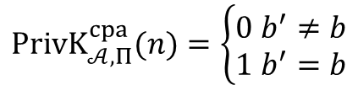
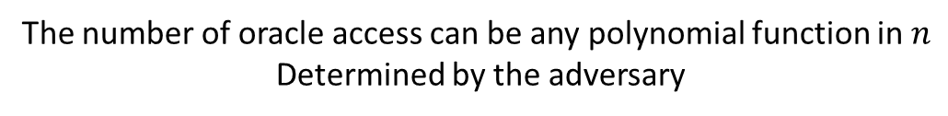
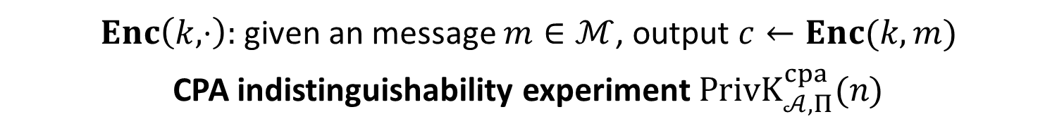


$$\text{Chosen}\text{−}\text{Plaintext} \text{Attack}$$
$Enc\left(k,⋅\right):$given an message $m∈ℳ$, output $c←Enc(k,m)$
CPA indistinguishability experiment $PrivK_{𝒜, Π}^{cpa}(n)$
$$k←Gen\left(1^{n}\right)$$
$$oracle access to$$
$$Enc\left(k,⋅\right)$$
$$m_{0},m_{1}$$
$$\left|m_{0}\right|=|m_{1}|$$
$$Challenger$$
$$b←\{0,1\}$$
$$Adversary 𝒜$$
$$c←Enc(k,m_{b})$$
$$c$$
$$oracle access to$$
$$Enc\left(k,⋅\right)$$
$$b′$$
$$PrivK_{𝒜, Π}^{cpa}(n)=\left\{\begin{aligned}0 b^{′}≠b \\ 1 b^{′}=b\end{aligned}\right.$$
The number of oracle access can be any polynomial function in $n$
Determined by the adversary

Slide 11
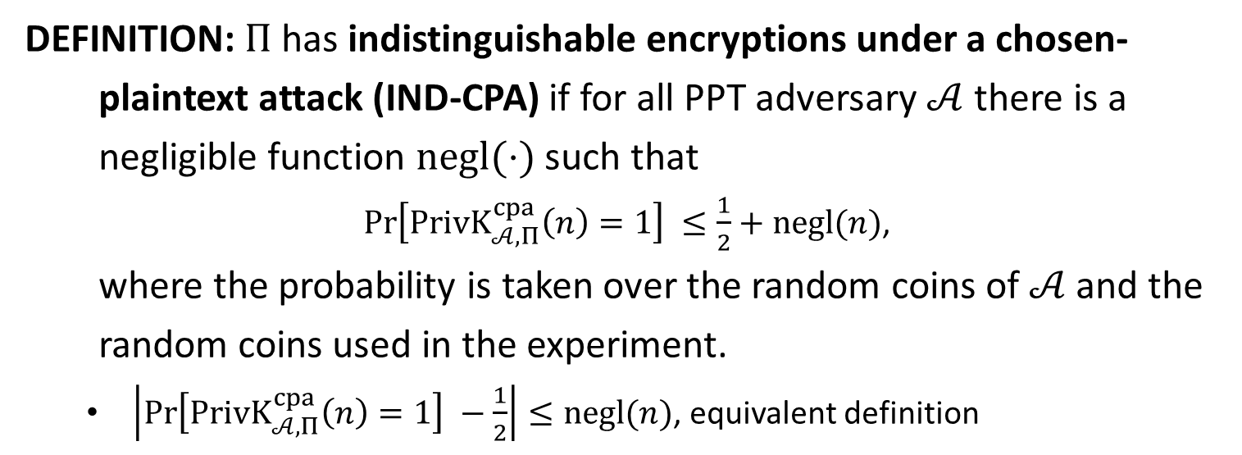
IND-CPA
DEFINITION: $Π$has indistinguishable encryptions under a chosen-
plaintext attack (IND-CPA) if for all PPT adversary $𝒜$ there is a
negligible function $negl(⋅)$ such that
$\operatorname{Pr}\left[PrivK_{𝒜, Π}^{cpa}\left(n\right)=1\right] ≤\frac{1}{2}+negl(n)$,
where the probability is taken over the random coins of $𝒜$ and the
random coins used in the experiment.
$\left|\operatorname{Pr}\left[PrivK_{𝒜, Π}^{cpa}\left(n\right)=1\right] −\frac{1}{2}\right|≤negl(n)$, equivalent definition

Slide 12


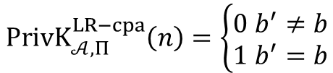
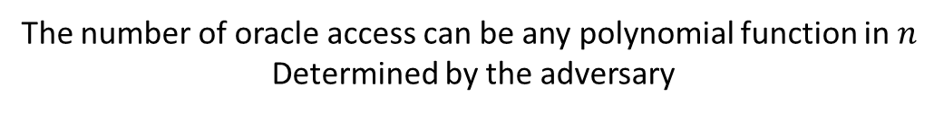






IND-m-CPA
$LR_{k,b}\left(⋅\right):$given $m_{0},m_{1}∈ℳ$, output $c←Enc(k,m_{b})$
LR-Oracle experiment $PrivK_{𝒜, Π}^{LR−cpa}(n)$
$$k←Gen\left(1^{n}\right)$$
$$b←\{0,1\}$$
$$oracle access to$$
$$LR_{k,b}(⋅)$$
$$Challenger$$
$$Adversary 𝒜$$
$$b′$$
$$PrivK_{𝒜, Π}^{LR−cpa}\left(n\right)=\left\{\begin{aligned}0 b^{′}≠b \\ 1 b^{′}=b\end{aligned}\right.$$
The number of oracle access can be any polynomial function in $n$
Determined by the adversary

Slide 13
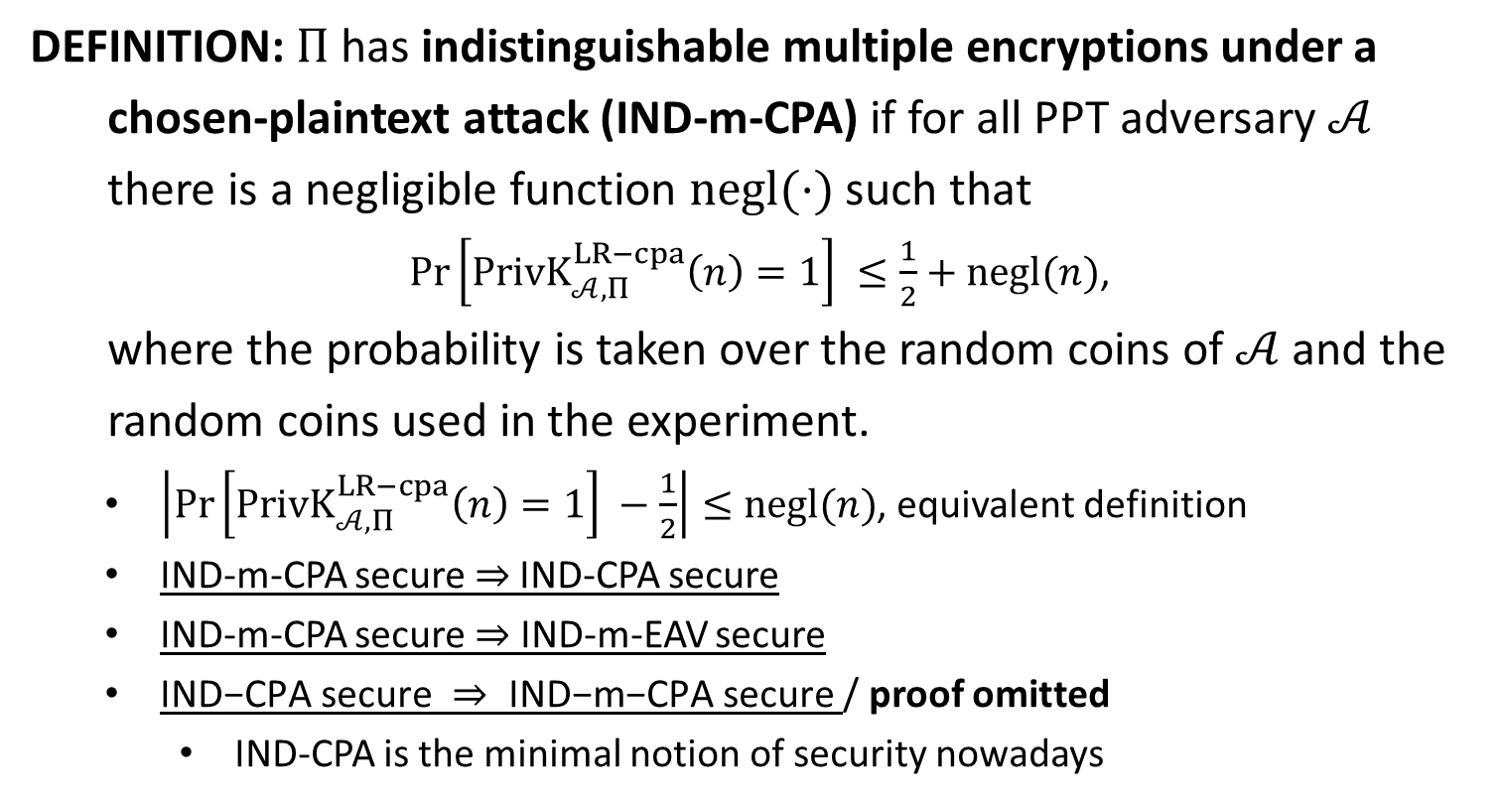
IND-m-CPA
DEFINITION: $Π$has indistinguishable multiple encryptions under a
chosen-plaintext attack (IND-m-CPA) if for all PPT adversary $𝒜$
there is a negligible function $negl(⋅)$ such that
$\operatorname{Pr}\left[PrivK_{𝒜, Π}^{LR−cpa}\left(n\right)=1\right] ≤\frac{1}{2}+negl(n)$,
where the probability is taken over the random coins of $𝒜$ and the
random coins used in the experiment.
$\left|\operatorname{Pr}\left[PrivK_{𝒜, Π}^{LR−cpa}\left(n\right)=1\right] −\frac{1}{2}\right|≤negl(n)$, equivalent definition
IND-m-CPA secure $⇒$IND-CPA secure
IND-m-CPA secure $⇒$ IND-m-EAV secure
$\text{IND}\text{−}\text{CPA} \text{secure} ⇒ \text{IND}\text{−}\text{m}\text{−}\text{CPA} \text{secure}$/ proof omitted
IND-CPA is the minimal notion of security nowadays

Slide 14













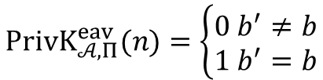




choose $M_{0}=(m_{0,1},…,m_{0,t})$
choose $M_{1}=\left(m_{1,1},…,m_{1,t}\right)$
$\left|m_{0,i}\right|=\left|m_{1,i}\right|, ∀ i$
IND-m-EAV
$$M_{0},M_{1}$$
$$k←Gen\left(1^{n}\right)$$
$$Challenger$$
$$b←\{0,1\}$$
$$Adversary 𝒜$$
$$c_{i}←Enc(k,m_{b,i})$$
$$C=(c_{1},…,c_{t})$$
$$b′$$
$$PrivK_{𝒜, Π}^{eav}(n)=\left\{\begin{aligned}0 b^{′}≠b \\ 1 b^{′}=b\end{aligned}\right.$$
IND-m-CPA
$$k←Gen\left(1^{n}\right)$$
$$b←\{0,1\}$$
$$oracle access to$$
$$LR_{k,b}(⋅)$$
IND-m-CPA is stronger than IND-m-EAV
$$Challenger$$
$$Adversary 𝒜$$
$$b′$$
$$PrivK_{𝒜, Π}^{LR−cpa}\left(n\right)=\left\{\begin{aligned}0 b^{′}≠b \\ 1 b^{′}=b\end{aligned}\right.$$

Slide 15











$$k←Gen\left(1^{n}\right)$$
IND-CPA
$$oracle access to$$
$$Enc\left(k,⋅\right)$$
$$m_{0},m_{1}$$
$$\left|m_{0}\right|=|m_{1}|$$
$$Challenger$$
$$b←\{0,1\}$$
$$Adversary 𝒜$$
$$c←Enc(k,m_{b})$$
$$c$$
$$oracle access to$$
$$Enc\left(k,⋅\right)$$
$$b′$$
$$PrivK_{𝒜, Π}^{cpa}(n)=\left\{\begin{aligned}0 b^{′}≠b \\ 1 b^{′}=b\end{aligned}\right.$$
IND-m-CPA
$$k←Gen\left(1^{n}\right)$$
$$b←\{0,1\}$$
$$orace access to$$
$$LR_{k,b}(⋅)$$
IND-m-CPA is stronger than IND-CPA
$$Challenger$$
$$Adversary 𝒜$$
$$b′$$
$$PrivK_{𝒜, Π}^{LR−cpa}\left(n\right)=\left\{\begin{aligned}0 b^{′}≠b \\ 1 b^{′}=b\end{aligned}\right.$$

